Slide 1
The video game industry
November 2023
in Catalonia

Slide 2

The video game industry in Catalonia
ACCIÓ
Government of Catalonia
The contents of this document are subject to a Creative Commons license. Unless otherwise indicated, reproduction, distribution and public communication is permitted as long as the author is cited, no commercial use is made and derivative works are not distributed. A summary of the license terms can be found at:
https://creativecommons.org/licenses/by-nc-nd/4.0/
The use of brands and logos in this report is merely informative. The brands and logos mentioned belong to their respective owners and are in no way owned by ACCIÓ. This is a partial illustrative profile of the companies, organizations and entities that form part of the video game ecosystem. There may be companies, organizations and entities that have not been included in the study.
Carried out by
Strategy and Competitive Intelligence Unit of ACCIÓ
Directorate General of Innovation and Digital Culture. Catalan Institute of Cultural Enterprises
Barcelona, November 2023

Slide 3



Contents
1. The video game industry
2. The video game industry in Catalonia
3. Trends and opportunities in the video game industry

Slide 4
1. The video game industry

Slide 5





Definition of the video game industry
The video game industry encompasses the entire sector related to the creation, development, publishing, distribution and monetization of video games. It’s a rapidly growing industry, with millions of people worldwide playing video games and generating billions of dollars of revenue each year.
The video game industry covers a wide range of products, which are grouped together in four major market segments: games for mobile devices, console games, downloadable/boxed PC games and browser games for PCs.
Production process for a video game
  Pre-production
  In essence, this phase defines what the game’s about, why it should be made and what it should cost to make it.
  Production
This phase may last between one and four years, and it’s the time when the game takes shape: the story is refined, the assets (e.g. characters and settings) are created, the rules of the game are established, the code is written, and so on.
  Post-production
After the production is completed and the game is released, the maintenance (fixing of bugs, creation of patches) and the generation of additional and downloadable content (DLC) takes place.
Source: ACCIÓ, based on Statista and CG Spectrum

Slide 6

The global video game industry (I)
The video game industry will have a turnover totaling 187.7 billion dollars in 2023. This figure represents 2.6% growth compared to 2022, despite the challenging macroeconomic factors. The sector is therefore continuing to stabilize in the wake of the turbulence caused by the COVID-19 pandemic. This path of growth is expected to continue, with the turnover reaching 212.4 billion dollars by 2026.
Turnover by market segment
Turnover by geographical region
  Games for mobile devices
  $92.6 B | ▲0.8% with respect to 2022
  Asia-Pacific
  $85.8 B | ▲1.2% with respect to 2022
  49%
  46%
  North America
  $51.6 B | ▲3.8% with respect to 2022
  Console games
  $56.1 B | ▲7.4% with respect to 2022
  27%
  30%
  Europe
  $34.4 B | ▲3.2% with respect to 2022
  18%
  Downloadable/boxed PC games
  $37.1 B | ▲1.6% with respect to 2022
  20%
  Latin America
  $8.8 B | ▲4.3% with respect to 2022
  5%
  Browser games for PCs
  $1.9 B | ▼16.9% with respect to 2022
  Middle East and Africa
  $7.2 B | ▲6.9% with respect to 2022
  1%
  4%
Source: ACCIÓ, based on Newzoo, 2023

Slide 7





































The global video game industry (II)
Most popular games (by daily average users, DAU/monthly average users, MAU)
Featured companies
Mobile devices
Subway Surfers
Clash of Clans
8 Ball Pool
Candy Crush Saga
My Talking Tom
Hill Climb Racing
Console
Grand Theft Auto V
Pokémon Scarlet/Violet
Fortnite
Call of Duty: MWII/ Warzone 2
Minecraft
Fall Guys
PC
Minecraft
The Sims 4
League of Legends
Fortnite
Roblox
Baldur’s Gate III
Note: For mobile devices the 2022 Android, iPhone and iPad data have been aggregated (by DAU), for consoles the 2022 Xbox, PlayStation and Nintendo Switch data have been aggregated (by MAU), and for PCs the data for 2023 (by MAU) have been used. Partial non-exhaustive profile
Source: ACCIÓ, based on Statista and Newzoo, 2023

Slide 8




















The global video game industry (III)
Main markets in 2022 (by turnover)*
Main companies in 2023 (by turnover)
Country | Turnover | Players
United States | $46.4 B | 209.8 M
China | $44.0 B | 699.6 M
Japan | $19.1 B | 73.4 M
South Korea | $7.4 B | 33.3 M
Germany | $6.5 B | 49.5 M
United Kingdom | $5.5 B | 38.5 M
France | $4.1 B | 38.8 M
Canada | $3.3 B | 22.0 M
Italy | $3.1 B | 36.1 M
Brazil | $2.6 B | 102.6 M
1
Tencent
6
Google
2
Sony
7
Activision Blizzard
3
Apple
8
Electronic Arts
4
Microsoft
9
Nintendo
5
NetEase
10
Take-Two Interactive
*Although India isn’t in the top ten by turnover, it’s the second-largest market in the world in terms of the number of players (373 M).
Source: ACCIÓ, based on Newzoo, 2023

Slide 9























The global video game industry (IV)
The volume of FDI in the video game industry, which registered a record high in 2022, reflects the reality of a market of a phase undergoing rapid expansion. Between 2003 and 2022, video games have established themselves as a major global industry.
FDI in video games around the world, 2003-2022
The 25 top investing companies in the period 2003-2022
1,324
projects
21,666.7
€M in investment
95,692
jobs created
Countries of origin by projects
Destination countries by projects
  1 United States | 320 projects
  1 United States | 169 projects
  2 United Kingdom | 133 projects
  2 United Kingdom | 157 projects
  3 Japan | 125 projects
  3 Canada | 133 projects
  4 France | 123 projects
  4 Germany | 81 projects
  5 China | 82 projects
  5 Spain | 55 projects
Note: Investments made in video games, applications and digital content activities have been taken into account
Source: ACCIÓ, based on fDi Markets

Slide 10






Catalonia elevates Spain to a prominent position in the international rankings
Over the last five years Spain has occupied an excellent position in the global rankings of FDI in video games. The countries in North America and Western Europe have received the most projects, as has occurred in the historical series as a whole.
Top 15 destination countries in the world (by projects)
2018-2022
  1 Canada | 64 projects
  6 France | 20 projects
  11 India | 11 projects
15
countries
  2 United Kingdom | 53 projects
  7 Japan | 16 projects
  12 Netherlands | 10 projects
  3 United States | 37 projects
  8 Poland | 16 projects
  13 China | 9 projects
351
projects
  4 Germany | 35 projects
  9 UAE | 16 projects
  14 Romania | 9 projects
  5 Spain | 34 projects
  10 Singapore | 14 projects
  15 Australia | 7 projects
The countries in North America and Western Europe account for 253 of the 351 projects (72.1%)
6 of the 15 main destination countries are in the EU, which accounts for 124 of the 351 projects (35.3%)
22 of the 34 projects undertaken in Spain in the last five years have been carried out in Catalonia (64.7%)
Note: Investments made in video games, applications and digital content activities have been taken into account
Source: ACCIÓ, based on fDi Markets

Slide 11
An eminently digital industry
The digital video game segment has undergone spectacular growth in recent years, in terms of both the proportion of players and the proportion of turnover, and this trend is expected to continue in the coming years. The forecasts indicate that the digital segment, which will bring together 72% of the players, will generate 96% of the turnover of the video game industry in 2027.
Global turnover of the industry by segments
Number of players worldwide by segments
Source: ACCIÓ, based on Statista

Slide 12











Video game users are a diverse and growing group (I)
The increase in revenue is expected to be accompanied by a rise in the number of players in all the regions, which will stand at 3,381 million in 2023. This will be a 6.3% increase with respect to 2022. The global penetration of video games (measured as the percentage of Internet users worldwide who play video games on any device) is similar for men and women and tends to decrease with age.
Number of players by geographical region
Global penetration of video games
  Asia-Pacific
  1,789 M | ▲5.7% with respect to 2022
  16 to 24 years of age
  53%
  87.3%
  89.7%
  Middle East and Africa
  574 M | ▲12.3% with respect to 2022
  25 to 34 years of age
  17%
  86.5%
  88.0%
  Europe
  447 M | ▲3.6% with respect to 2022
  35 to 44 years of age
  81.9% in the world aged 16 to 64
  13%
  80.6%
  84.8%
  Latin America
  335 M | ▲6.1% with respect to 2022
  45 to 54 years of age
  10%
  74.2%
  76.9%
  North America
  237 M | ▲2.4% with respect to 2022
  55 to 64 years of age
  7%
  65.4%
  66.7%
Source: ACCIÓ, based on Newzoo, 2023; Digital 2023: Global Overview Report

Slide 13
Video game users are a diverse and growing group (II)
Shooter and action and adventure video games were the most popular around the world in 2022. Shooters are classified as the most popular genre in practically all the age groups; the only exceptions are Internet users aged 45 to 54 and 55 to 64, among whom they occupy the second position. Action and adventure games are the most popular genre in two of the age groups and the second most popular in the other three.
Most popular video game genres
  16 to 24 years of age
  1 Shooter
  2 Action and adventure
  3 Simulation
  4 MOBA
  5 Sports
  6 Courses
  7 Battle royale
  8 Strategy
  9 Puzzles
  10 Fighting
  25 to 34 years of age
  1 Shooter
  2 Action and adventure
  3 Courses
  4 Sports
  5 MOBA
  6 Simulation
  7 Strategy
  8 Puzzles
  9 Fighting
  10 Action (platforms)
  35 to 44 years of age
  1 Shooter
  2 Action and adventure
  3 Sports
  4 Courses
  5 Puzzles
  6 Strategy
  7 Simulation
  8 Action (platforms)
  9 MOBA
  10 Fighting
  45 to 54 years of age
  1 Action and adventure
  2 Shooter
  3 Puzzles
  4 Courses
  5 Sports
  6 Strategy
  7 Simulation
  8 Action (platforms)
  9 Fighting
  10 MOBA
  55 to 64 years of age
  1 Action and adventure
  2 Shooter
  3 Puzzles
  4 Sports
  5 Courses
  6 Simulation
  7 Strategy
  8 Action (platforms)
  9 Board video games
  10 MOBA
Note: MOBA stands for Multiplayer Online Battle Arena
Source: ACCIÓ, based on Digital 2023: Global Overview Report

Slide 14



eSports have become a central component of the online video game culture (I)
eSports are organized multi-player video game competitions involving professional players, either as individuals or in teams. The boom in the number of professional players and the increase in the popularity of live broadcasts of eSport events has led to the creation of tournaments and leagues.
Global eSport audience (in M)
The eSport market has surged in recent years and more and more viewers want to watch their favorite video games played by some of the best gamers in the world.
The global eSport audience is expected to increase by 47.1% between 2020 and 2025
The eSport market in Europe grew by 16.5% between 2018 and 2020 (from 79 to 92 million viewers)
Twitch and YouTube were the main Gaming Video Content (GVC) platforms by worldwide share of turnover in 2020. Twitch accounted for 22% of the GVC turnover in the period under study, while YouTube accounted for 18%.
Source: ACCIÓ, based on Statista, 2023

Slide 15
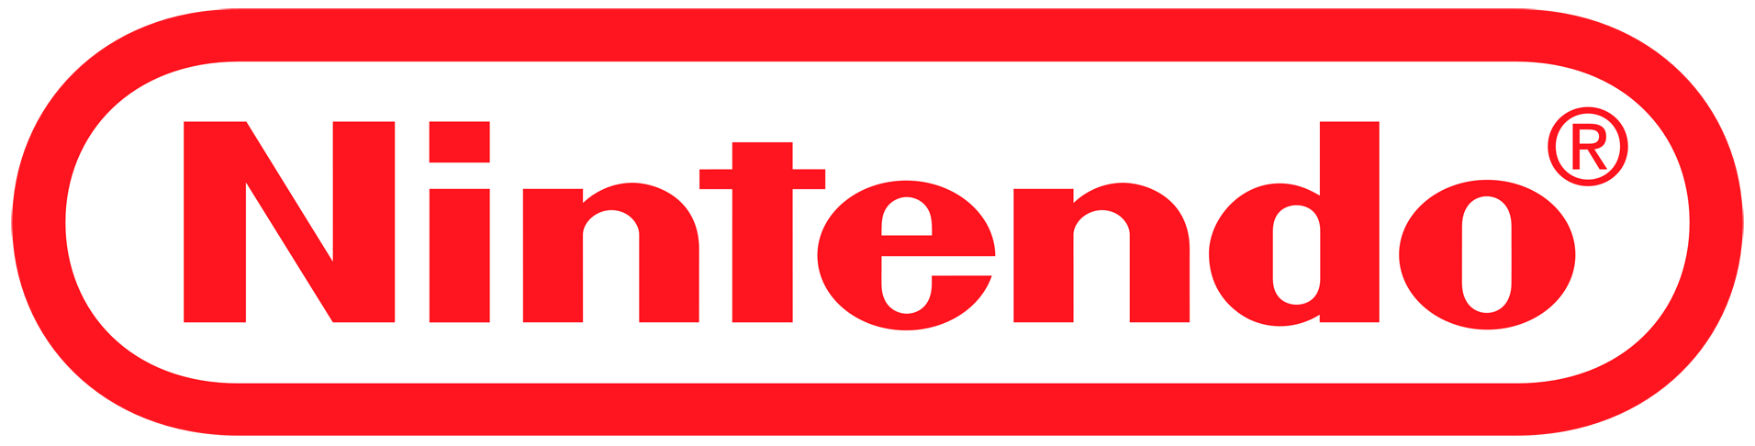





eSports have become a central component of the online video game culture (II)
Global eSport turnover (in €M)
Global eSport turnover in 2021
The combined turnover of the 3 main regions totaled $808.90 M
China
$360.10 M
United States
$243 M
Western Europe
$205.80 M
Companies with the largest share of the global eSport market in 2021
1
Activision Blizzard
21.85%
6
Nintendo
2.82%
2
MTG
14.15%
7
TSM
2.10%
3
Tencent
11.04%
8
Cloud9
1.96%
The global eSport turnover is expected to grow by 87.4% between 2020 and 2025. In 2022, sponsorships and media rights were the segments with the largest proportion of the total turnover (1,384 million dollars).
4
Valve Corporation
8.03%
9
Take-Two Interactive
1.87%
5
EA
3.78%
10
Riot Games
1.40%
Source: ACCIÓ, based on Statista, 2023

Slide 16
2. The video game industry in Catalonia

Slide 17



The huge potential of Catalan video games is acknowledged both at home and abroad
The Catalan ecosystem: competitive and innovative for video games
Catalonia is the engine of the Spanish video game ecosystem, accounting for 52% of its turnover.
The turnover of Catalan video games underwent 20% year-on-year growth in 2021.
Catalonia accounts for approximately half of the workers and turnover recorded in Spain in 2021.
In the 2017-2021 five-year period, the number of workers and the turnover grew by 42.5% and 79.8% respectively.
On the global radar for video game investment
Catalonia is the leading region in the European Union in terms of the number of FDI projects for video games, the second most important for jobs generated by FDI and the third most important with regard to volume of invested capital.
In the 2018-2022 five-year period, Catalonia was the third most important FDI destination region in the world for video games in terms of the number of projects. It has more projects alone than entire countries such as France, the Netherlands, China, Japan and Australia.
Renowned companies such as Rovio, NetEase Games and Infinity Ward have set up their headquarters in Catalonia in 2023.
A local and international talent hub in a highly creative environment
Barcelona is the ninth most popular city in the world to work in for foreigners (Decoding Global Talent, BCG 2021).
Barcelona is the sixth best city in Europe for arts, culture and entertainment (Resonance Consultancy, 2023).
Barcelona is the leading non-capital city in the EU for attracting people, capital and global companies (GPCI, 2022).
Source: ACCIÓ

Slide 18



Almost 200 companies and studios make up the video game industry in Catalonia
  196 companies and studies
  ▼2%
  26% of Spain
  €660 M
  of turnover
  ▲20%
  52% of Spain
  4,249 employees
  ▲7%
  48% of Spain
  Active companies: 132
  ▲7%
  Non-incorporated studios: 64
Note: The data correspond to 2021 and the increases shown are with respect to 2020
Source: ACCIÓ, based on the 2022 White Paper on the Catalan video game industry

Slide 19


The turnover and employment generated by the video game industry is growing year by year
Evolution of the Catalan video game industry, 2017-2021
The percentage of women in Catalan studies is yet to represent equality, although the trend in recent years has been an upward one.
2,982 employees
3,282 employees
3,381 employees
3,996 employees
4,249 employees
€367 M
€429 M
€473 M
€552 M
€660 M
2017
17%
83%
190
200
196
2018
166
167
18%
82%
▲1%
2019
20%
80%
▲2%
2020
25%
75%
▲5%
2021
25%
75%
=
Source: ACCIÓ, based on the 2022 White Paper on the Catalan video game industry

Slide 20





Barcelona, a pole of attraction for companies and video game studios
Most of the companies devoted to the creation of video games are located in Barcelona, while the others are distributed almost uniformly across the other Catalan provinces. Their sales are particularly focused on Europe (43%) and North America (36%), the regions which have emerged as the main markets for Catalan video games.
Catalan companies by demarcations, 2021
Catalan video game turnover by regions, 2021
  1
Europe (43%)
  Barcelona
  90%
  Tarragona
  4%
Spain (13%) + Rest of Europe (30%)
  2
North America (36%)
  3
Asia-Pacific (12%)
  Girona
  3%
  Lleida
  3%
  4
Latin America (7%)
  5
Middle East and Africa (2%)
Source: ACCIÓ, based on the 2022 White Paper on the Catalan video game industry

Slide 21
The forecasts indicate that Catalan video games will undergo a highly favorable evolution
Forecast for the evolution of the turnover (in €M)
Forecast for the evolution of the number of workers
The growth estimates for the 2021-2025 period are excellent. Aggregate growth totaling 16.5% is expected, with the turnover reaching €1,216 M by 2025. This means the 2021 result will be almost doubled.
The forecasts regarding the number of workers are also excellent. Aggregate growth totaling 11.5% is expected in the 2021-2025 period. The video game industry will therefore employ 6,564 people in 2025.
Source: ACCIÓ, based on the 2022 White Paper on the Catalan video game industry

Slide 22







































Profile of the video game companies and studios in Catalonia (I)
Video game development studios and companies
Publishers of video games
Other video game companies
Includes companies that create art for video games, immersive experiences and gamified solutions.
95% of the total number of companies in Catalonia are video game developers
Of the total number of developers in Catalonia:
66% have been incorporated as companies and remain active
34% are non-incorporated studios
20% of the total number of companies in Catalonia are publishers of video games
3% of the total number of companies in Catalonia are in this category
Note: Partial non-exhaustive profile. The companies may be both developers and publishers of video games
Source: ACCIÓ

Slide 23



Profile of the video game companies and studios in Catalonia (II)
14% of the total number of companies and studios in Catalonia are startups
By counties
The main counties by number of video game companies and studios are El Barcelonès (64%), El Vallès Occidental (9%) and El Baix Llobregat (8%). The remaining counties display percentages below 5%.
13% of the total number of companies and studios in Catalonia are subsidiaries of foreign companies
By volume of turnover and workers
The trend is towards a concentration of the turnover and workers in the largest companies; the studios that bill over €50 M per year (only 1%) account for 47% of the total billed in Catalonia, while the studios with over 50 workers employ 53% of the sector.
12% of the total number of companies and studios in Catalonia are regular exporters
By experience
A large number of the studios based in Catalonia are adult, with histories ranging between 5 and 10 years (37%) or exceeding 10 years (22%). However, the entrepreneurial component is important, given that 19% of the studios are less than two years old.
Note: Partial non-exhaustive profile
Source: ACCIÓ, 2022 White Paper on the Catalan video game industry

Slide 24



Profile of the video game companies and studios in Catalonia (III)
Main companies and studios in Catalonia by volume of turnover
Main companies and studios in Catalonia by number of employees
1
Socialpoint
1
King
2
King
2
Socialpoint
3
Scopely
3
Zitro
4
Zitro
4
Scopely
5
Gameloft
5
Gameloft
6
Ubisoft
6
Ubisoft
7
Bandai Namco Mobile
7
Omnidrone
8
Starloop Studios
8
Ubisoft Barcelona Mobile
9
ZeptoLab
9
Novarama
10
Tangelo Games
10
ZeptoLab
Note: According to the latest data published by companies in the video game industry
Source: ACCIÓ

Slide 25









Companies and studios in Catalonia according to the phase of the video game creation process
Pre-production
Production
Launch
Post-production
Venture capital
Art
Marketing and PR
Location
Incubators/accelerators
Programming
User acquisition
Game porting
Outsourcing*
Sound and music
*Includes concept art, prototyping, etc.
Quality assurance/testing
Funding
Note: Partial non-exhaustive profile. Companies are included in each phase of the process for purely illustrative purposes
Source: ACCIÓ

Slide 26






























Main video game companies and studios in Catalonia (I)
Sample of local non-incorporated companies and studies
Sample of international companies in Catalonia
United States of America
United Kingdom
Sweden
France
Ireland
Singapore
Canada
South Korea
Japan
Malta
Note: Partial non-exhaustive profile
Source: ACCIÓ

Slide 27








Main video game companies and studios in Catalonia (II)
Year | Startups | Change
2018 | 39 | -
2019 | 45 | ▲15%
2020 | 49 | ▲9%
2021 | 49 | =
2022 | 56 | ▲14%
2023 | 57 | ▲2%
Catalonia currently hosts 57 startups related to the video game industry, a figure representing a 46% increase with respect to 2018.
Omnidrone, which was founded in 2013, is a video game development studio geared towards tablets and mobile platforms. In 2022 it was purchased by the Scopely company from California, which had already been an investor since 2018.
Rubiko is an expert in the field of customer service and payment services tailored to the iGaming industry.
Ludium is a B2B technology company which has developed application virtualization technology and interactive streaming via the cloud at a reduced cost.
Main Catalan video game startups (by turnover)
Barcelona is the second most popular startup hub in the European Union among the founders of these types of companies
Startup Heatmap Europe, 2022
Source: ACCIÓ, based on the Barcelona & Catalonia Startup Hub

Slide 28











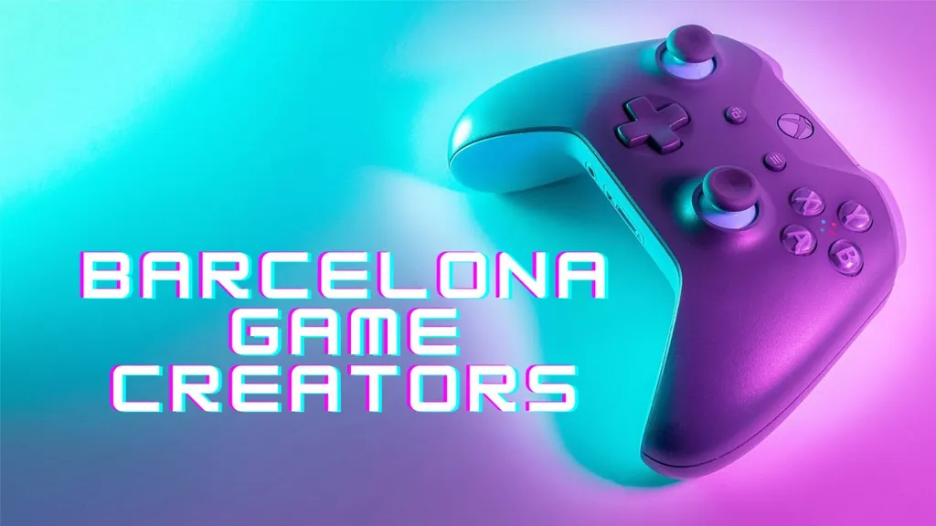























































The video game industry ecosystem in Catalonia
Associations and bodies related to the video game industry
Catalan universities with specific training in the video game industry
Clusters
Catalan universities with training related to video games
Public institutions that support the video game industry
Centers with training related to video games
Fairs and congresses related to the video game industry in Catalonia
ICT coding bootcamps in Catalonia
Technological centers that support the video game industry
Source: ACCIÓ. Sample of the main representatives in each category

Slide 29






Catalonia, a technological hub with international renown
Barcelona is the...
second-ranked European city, after London, for its technological ecosystem approach
(Financial Times, 2020)
top non-capital tech city in Europe
(Savills Tech Cities Index, 2019)
second most technological city in southern Europe
(Tech Cities of the Future, Financial Times, 2021)
ninth most popular city in the world to work in for foreigners
(Decoding Global Talent, Boston Consulting Group, 2021)
second-ranked city in southern Europe in terms of capital invested in technological companies
(State of European Tech, Atomico, 2022)
Source: ACCIÓ

Slide 30





Projects led by Catalan technological centers related to video games
Innovative technological solutions for the design, implementation and validation of serious games and gamification. Vocational training, detection, rehabilitation and education. One example is Virtual Perfusionist, a serious game about surgical operations developed by the Polytechnic University of Catalonia and the Hospital Clínic de Barcelona.
The IBEC’s researchers have developed a system based on virtual reality to rehabilitate patients suffering from Broca aphasia. It has been proven that RGS improves frequency and communicative effectiveness in daily life.
Digital games for the elderly are new kinds of games that can reinforce and exploit their strengths as individuals and players, reduce isolation, encourage socialization and improve their physical and psychosocial welfare.
The Sim4Nexus project is a video game (a serious game) in the form of an online simulator that enables users to understand the results of environmental management policies, with a cross-cutting approach at different levels.
EduGame4City. The project consists of design and gamified implementation for 3D visualization with virtual and augmented reality systems for real cases in the city of Barcelona, such as the so-called superilles or super-islands. And it gives rise to a study to improve motivational, spatial, social and user-related skills.
It will form part of the GAME4CITY project, coordinated with the UPC, and its main aim is to improve architectural teaching and student competences.
GameTools develops games that test the internal systems of representation of companies and provide demonstrators to demonstrate the viability of the methods developed.
MED GAIMS is an experimental tourism project that seeks to encourage and improve experiences through gamification.
Source: ACCIÓ

Slide 31










An excellent location for foreign investments
In the 2018-2022 five-year period Catalonia remained an important pole of attraction for FDI in video games in Spain. It is becoming established as the primary destination in the State in terms of the numbers of projects and jobs created through FDI.
3 of the 7 cities that have received FDI (43%) in this five-year period in Spain are Catalan:
Main countries of origin (by projects)
22 projects
▲267% with respect to 2013-2017
64.7%
of the total in Spain
  1 France
  6 South Korea
1 Barcelona
2 Madrid
3 Ceuta
4 Málaga
5 Alicante
6 Sant Cugat del Vallès
7 Sitges
  2 Sweden
  7 Australia
€128.8 M in investment
▲110% with respect to 2013-2017
44.9%
of the total in Spain
  3 United States
  8 Belgium
1,142 jobs created
▲127% with respect to 2013-2017
45.1%
of the total in Spain
  4 Denmark
  9 Cyprus
  5 Poland
  10 Finland
Sample of investing companies in Catalonia in the 2018-2022 period
Note: Investments made in video games, applications and digital content activities have been taken into account
Source: ACCIÓ, based on fDi Markets

Slide 32







Catalan talent, a major factor in attracting foreign investment
According to the companies that have invested in the 2018-2022 five-year period, there are several incentives consolidating Catalonia as a top-level international destination for FDI in video games.
1 Availability of qualified talent
Mentioned in 83.3% of the projects
4 Technology and innovation
Mentioned in the 16.6% of the projects
2 Industrial cluster
Mentioned in 41.6% of the projects
5 Transport infrastructure
Mentioned in 8.3% of the projects
3 Quality of life
Mentioned in 25.0% of the projects
6 Domestic market growth
Mentioned in 8.3% of the projects
Note: Investments made in video games, applications and digital content activities have been taken into account
Source: ACCIÓ, based on fDi Markets

Slide 33

Catalonia is the third-ranked destination region for FDI in video games in the world
Catalonia occupies a very high position in the world in terms of FDI in video games. In the 2018-2022 five-year period it was the third-ranked destination region for projects, the twelfth-ranked destination region for capex and the seventh-ranked destination region for jobs generated by FDI.
Main regions of origin in the world
Main destination regions in the world
2018-2022 (by projects)
  2013-2017 five-year period
  Catalonia | Position 51
  1 project
  2018-2022 five-year period
  Catalonia | Position 15
  7 projects
2018-2022 (by projects)
  2013-2017 five-year period
  Catalonia | Position 10
  6 projects
  2018-2022 five-year period
  Catalonia | Position 3
  22 projects
  1 California | 77 projects
  1 Quebec | 39 projects
  2 Île-de-France | 37 projects
  2 South-east | 27 projects
  3 Sweden | 35 projects
  3 Catalonia | 22 projects
  4 Guangdong | 24 projects
  4 Berlin | 19 projects
  5 Kanto | 19 projects
  ▲36 positions
  5 California | 17 projects
  ▲7 positions
  ...
  15 Catalonia | 7 projects
Note: Investments made in video games, applications and digital content activities have been taken into account
Source: ACCIÓ, based on fDi Markets

Slide 34
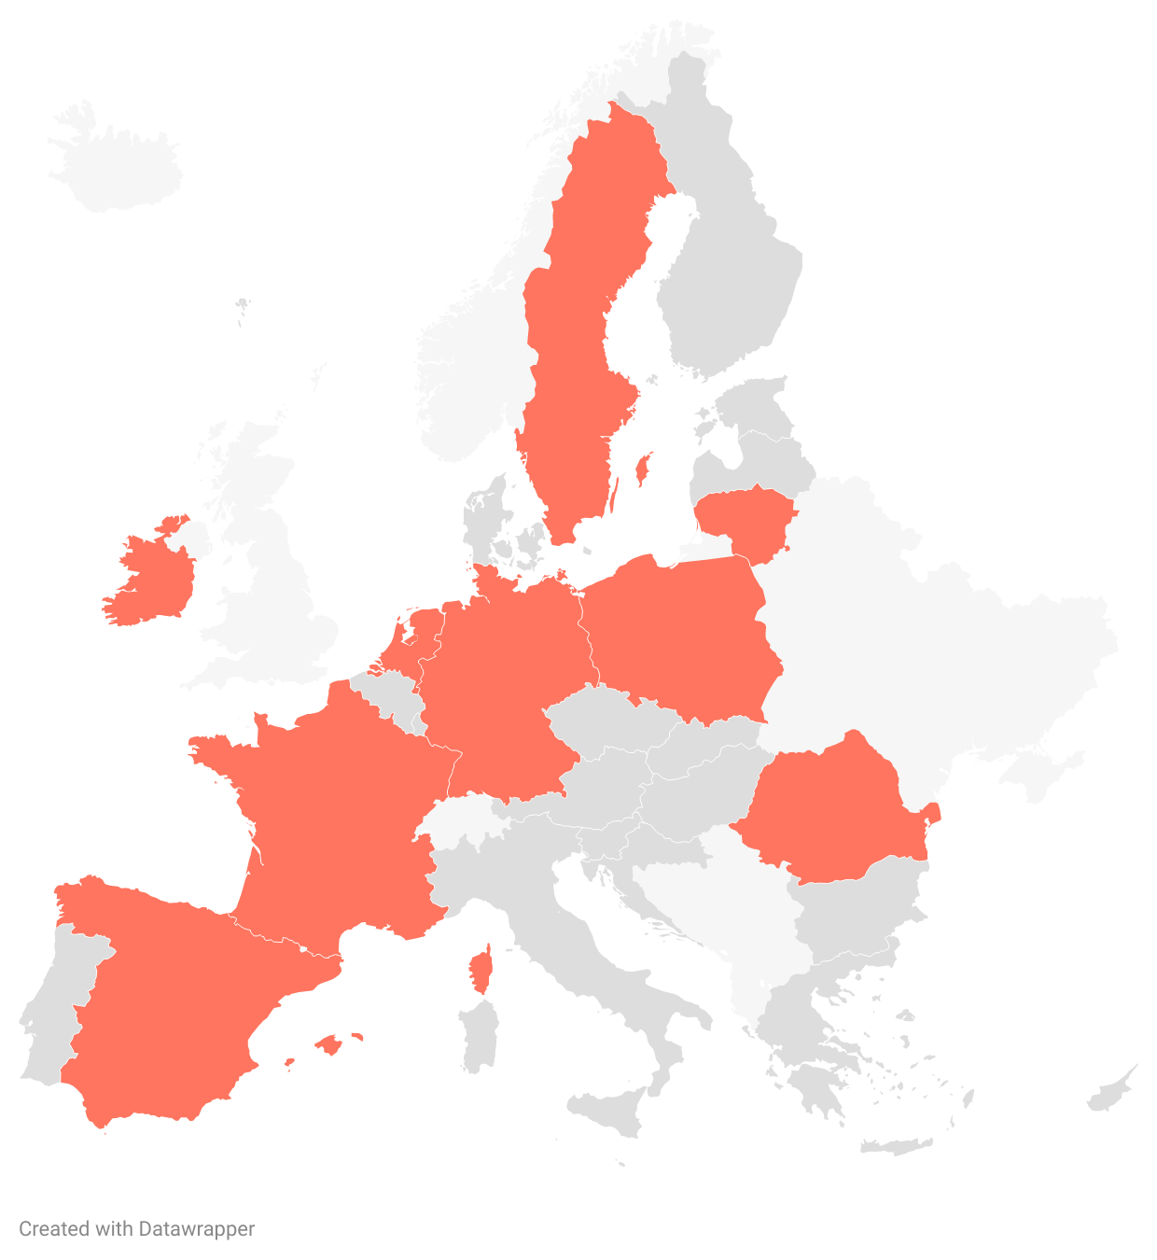




Catalonia is the first region in the EU in terms of the number of FDI projects for video games
In the 2018-2022 five-year period, Catalonia occupied an excellent position in the European Union for FDI in video games. It’s the first region as regards the number of projects, the third-ranked for invested capital and the second-ranked for jobs created.
FDI in video games in the EU (by projects), 2018-2022
1st-ranked region as regards number of projects
12.3% with respect to the EU total
8th Sweden
10th Ireland
3rd-ranked region as regards invested capital
9.2% of the EU total
7th Lithuania
2nd-ranked region as regards jobs generated
10.7% of the EU total
6th West Netherlands
3rd Poland
4th Île-de-France
5th Romania
2nd Berlin
Note: Investments made in video games, applications and digital content activities have been taken into account
Source: ACCIÓ, based on fDi Markets
9th C. of Madrid
1st Catalonia

Slide 35





The large international companies are choosing Barcelona
Infinity Ward, the creator of Call of Duty, chooses Barcelona as a hub for its European expansion
FunPlus, the Swiss video game company, is set to create 120 new jobs at its studio in Barcelona
Infinity Ward, the American video game developer, will be based at the headquarters of Digital Legends in Barcelona, and the two companies will work together on the development of Call of Duty projects.
FunPlus, one of the global leaders in strategy video games, including State of Survival, Guns of Glory and King of Avalon, will create 120 new jobs at its Barcelona studio as part of its expansion plans.
Further information
Further information
BIG C will open the largest eSports center in southern Europe in Barcelona
The developer of the Angry Birds video game chooses Barcelona to open its first studio in southern Europe
The new premises, which will seek to position themselves as the flagship high-performance center in the field of video games in Europe, will be located in Barcelona and they will be the largest center in southern Europe competing in video games and eSports.
Finnish company Rovio will create around 30 jobs with the opening of a new studio in Barcelona, which will become the company’s first premises in southern Europe.
Further information
Further information
NetEase Games, the Chinese video game company, opens a new studio in Barcelona
Video game company IO Interactive creates 150 new jobs in Barcelona
NetEase Games, a leading provider of Internet services and games, has announced the creation of a new video game studio known as Anchor Point Studios. It will be devoted to developing action and adventure games for consoles and PCs.
IO Interactive, the Danish video game company, has announced the expansion of its studio in Barcelona. It currently has 30 employees and it plans to create 150 new jobs over the next four years.
Further information
Further information
Source: ACCIÓ

Slide 36




The recruitment of Catalan talent is set to undergo significant growth in 2022
2022 has been a good year for FDI-based job creation in the video game industry. In addition to year-on-year growth in terms of the number of jobs, both Catalonia and Barcelona have once again achieved leading positions in the international rankings. The appeal of Catalonia in seducing foreign markets is therefore evident.
FDI-based job creation, 2021-2022
The potential of Catalan human capital
In 2022, the availability of skilled labor was the main reason why investment companies chose Catalonia. This indicates excellent prospects for job creation in the future.
286
Jobs created in 2021
377
Jobs created in 2022
▲32%
year-on-year growth
Catalonia, 2022
Catalonia, 2022
Barcelona, 2022
5th-ranked region in the world in terms of FDI-based job creation in video games
▲1 position with respect to 2021
3rd-ranked region in the EU in terms of FDI-based job creation in video games
▼1 position with respect to 2021
2nd-ranked region in the EU in terms of FDI-based job creation in video games
= with respect to 2021
Note: Investments made in video games, applications and digital content activities have been taken into account
Source: ACCIÓ, based on fDi Markets

Slide 37






Catalonia, a pole of attraction for young professionals, researchers and video game developers
Barcelona is the ninth most popular city in the world to work in for foreigners
(Decoding Global Talent, Onsite and Virtual, 2021, Boston Consulting Group)
Catalonia is the 7th-ranked region in the EU 27 in terms of digital human capital
(DESI, 2021)
Barcelona, the 5th-ranked European city in terms of the number of creative jobs
(Cultural and Creative Cities Monitor, European Commission, 2019)
Barcelona is the 13th most attractive European city for students
(QS Best Student Cities, 2022)
“To create a high-quality video game you need talent, and you can find this talent in Barcelona”
Sea, mountains and gastronomy, and cultural, artistic and architectural heritage that’s unique in the world
Cost of living
Quality of life
Compared to other large European cities, Barcelona has a more attractive cost of living.
(fDi Benchmark, 2022)
Barcelona - 58.0
Barcelona, 2nd-ranked city in the world for quality of life
(Global Power City Index, 2022, Institute for Urban Strategies - The Mori Memorial Foundation)
Barcelona, 5th-ranked European city for quality of life in tech lifestyle
(Tech Cities, 2020, Savills)
Spain is the healthiest country in the world
(Healthiest country index, Bloomberg, 2020)
Berlin - 72.2
Barcelona has a lot of highly competitive labor costs with top-level professionals from all over the world.
(fDi Benchmark, 2022)
Paris - 77.8
London - 83.4
Barcelona is the 7th most attractive city for office prices ($250/week) and co-working premises ($380/month), according to Tech Cities in Motion, 2019.
(Cost of Living Index by City, 2022, Numbeo)
Source: ACCIÓ and fDi Benchmark, 2022

Slide 38


Talent
Students enrolled on master’s and university degrees related to the video game industry in the 2021-2022 academic year.
Students enrolled on degrees and training courses related to the video game industry in Catalonia in the 2020-2021 academic year.
Of the total number of students enrolled in Spain on master’s and undergraduate degrees related to the video game industry, around 34% study in Catalonia (1,186 students).
Of the total number of students enrolled in Catalonia, those related to the video game industry total 2,189.
Undergraduate courses and master’s degrees
Degree in artistic creation for video games and applied games
Degree in video game design and development
Degree in video game design and production
Degree in computer engineering in management and information systems / degree in video game design and production
Degree in multimedia, applications and video games
Master’s degree in video game design and programming
Undergraduate courses and training cycles
3D animation, games and interactive environments
3D animation, games and interactive environments (virtual worlds, augmented reality and gamification)
Development of multi-platform applications (video games and digital entertainment)
By sexes, the distribution of students in Catalonia is:
By sexes, the distribution of students in Catalonia is:
  85%
  15%
  82%
  18%
Of the total number of people enrolled in the State on master’s degrees and undergraduate courses related to the video game industry, 20% are women.
Source: ACCIÓ

Slide 39


Barcelona also stands at the forefront of coding bootcamp training and digital training
40% of the Spanish centers that offer bootcamps are located in Barcelona. Most of the bootcamps in Barcelona are newly-created (82% have been set up there in the last five years).
Source: ACCIÓ, based on Digital Talent Overview 2021, Barcelona Digital Talent; The Best Barcelona Coding Bootcamps of 2022, Course Report

Slide 40
Barcelona offers extremely competitive operating costs in Europe
Barcelona has the most competitive labor costs of 8 similar cities that are similar in comparison. This is an important feature that makes it even more attractive for international investors seeking to do business in Catalonia.
Salary of a software programmer
Salary of a software engineer developer
Salary of a video game designer
Source: ACCIÓ, based on fDi Benchmark, 2023. Unit costs

Slide 41



























Barcelona supports talented people in vulnerable situations
The BCN Inclusive Coding project is a public-private partnership that supports talented people in vulnerable situations throughout all of the stages of the process until they are trained as digital professionals. 4 lines of action have therefore been identified to allow future digital talent to gain access to all the resources and tools enabling them to join the labor market.
Objectives
Lines of action
Companies committed to the project
  Incorporate 10,000 digital professionals over the next 10 years to combat the digital gap.
  Reduce social exclusion
  Drive digital training
  Promote social responsibility
  Generate a vocation for digital professions
Capture
Training advice
Digital training
Access to the market
Connection with the network and community of the Red Cross in Catalonia to identify people likely to be trained in the digital field.
Promotion of an external mentoring program made up of different social entities to advise people on the technical and cross-disciplinary skills they need to develop.
Training centers and social organizations in Catalonia, such as MigraCode Barcelona (migrants and refugees), Factoria F5 (women and the long-term unemployed), Fundació Esplai (young people, migrants and people in a vulnerable situation) and Barcelona Activa.
Organization of a recruitment day for companies and talent, with the aim of connecting digital profiles with technological companies and facilitating their inclusion in the labor market.
Once the profile is recruited, he/she will have an internal mentor to guarantee the success of the insertion process.
Promoted by:
Source: ACCIÓ, based on the 2022 Barcelona Inclusive Coding report by Barcelona Digital Talent

Slide 42
3. Trends and opportunities in the video game industry

Slide 43


Level up: the major trends and technologies set to transform the video game industry
The future of the video game industry
The technologies set to revolutionize the sector
Live-service games for PCs and consoles
Transformation of the competitive landscape
User-generated content (UGC)
Complementary gaming devices
Play-to-earn approach
Importance of diversity, equity and inclusion
Impact of new privacy policies
In-game advertising
New actors on the world stage
Video game studios run by influencers
Serious games as a training method
Gamification for other economic activities
Generative artificial intelligence (AI)
Virtual Reality (VR) and Augmented Reality (AR)
Metaverse
Cloud gaming
Web3 and blockchain technology
Source: ACCIÓ, based on Global Games Market Report, Newzoo, 2022 and 2023; White paper on Spanish video game development, DEV, 2022; Video Games in Spain, Euromonitor, 2023; Two Technology Trends Shaping The Future Of Gaming, Forbes, 2023; The Gaming Playbook, GWI, 2021

Slide 44


Trends in the video game industry (I)
1 | The unquestionable rise of live-service games for PCs and consoles
Console and PC developers are focusing more and more on live-service games: games that the developers maintain over an extended period with new contents for players to enjoy and purchase over time.
League of Legends is a successful MOBA video game released in 2009, developed and published by Riot Games, which has an office in Barcelona. It’s been on the market for over a decade but it shows no signs of slowing down; the team aims to keep the game fresh with the regular introduction of patches that include fixes, improvements and new contents.
2 | The ecosystems are intermingling and the competitive landscape is being transformed
Cross-platform games, coupled with the subsequent increase in the range of live-services and game subscriptions, have blurred the boundaries between gaming communities on the different platforms.
Gameloft Barcelona is the studio tasked with developing Disney Speedstorm, a video game in which Disney characters embark on hectic kart races on tracks based on the worlds in their films. It allows for cross-platform play, in such a way that the players can gather together for the same game, no matter what device they’re playing on.
3 | User Generated Content (UGC): a strategy to boost interaction, retention and content
User-generated content has been a constant in the video game industry for decades, but the popularization of the free-to-play format, social games and the metaverse has taken this phenomenon to new heights.
The Unreal Editor for Fortnite (UEFN) application is the foundation of the UGC strategy of Epic Games, the company that’s developed one of the most popular video games in history: Fortnite. It’s a publisher that seeks to empower creators by allowing them to directly design, develop and publish games and experiences in Fortnite.
Source: ACCIÓ, based on Global Games Market Report, Newzoo, 2022 and 2023; White paper on Spanish video game development, DEV, 2022; Video Games in Spain, Euromonitor, 2023; Two Technology Trends Shaping The Future Of Gaming, Forbes, 2023; The Gaming Playbook, GWI, 2021

Slide 45

Trends in the video game industry (II)
4 | A new rising star: complementary gaming devices are gaining ground
Different manufacturers and platform owners are working on enabling gamers to take their console and PC games wherever they like. These products are intended to be secondary to consumers’ primary gaming devices.
In 2017, Nintendo brought an innovative hybrid approach to the console market with the launch of the Switch. This console enables users to play in three different modes that adapt to all kinds of situations: TV, desktop and laptop. The new feature proved to be a great success with consumers and changed the way many people interacted with video games.
5 | The innovative play-to-earn approach is revolutionizing traditional video game business models
There’s currently a boom in play-to-earn models through which players can monetize their in-game activities and achievements. This concept encourages player participation and democratizes the game by providing opportunities to earn money.
Games for a Living (GFAL) is a platform that develops video games with blockchain technology with its offices in Barcelona. In 2022 it released Elemental Raiders, a play-to-earn action and strategy role-playing video game based on turn-based combat in which the users earn rewards by winning combats and trading their in-game goods with other players.
6 | Diversity, equity and inclusion are aspects that are gaining importance in video games
Companies are starting to include under-represented groups such as women, ethnic minorities, the LGBTQIA+ community and people with disabilities in their contents, policies and workforces.
Diversity stimulates innovation, which is why Activision Blizzard is creating an environment in which differences are accepted, valued, celebrated and always welcome. Activision’s Inclusive Game Design team is on a mission to integrate best practices and innovations into all of its games to ensure they’re the most diverse, welcoming and inclusive.
Source: ACCIÓ, based on Global Games Market Report, Newzoo, 2022 and 2023; White paper on Spanish video game development, DEV, 2022; Video Games in Spain, Euromonitor, 2023; Two Technology Trends Shaping The Future Of Gaming, Forbes, 2023; The Gaming Playbook, GWI, 2021

Slide 46

Trends in the video game industry (III)
7 | New privacy policies are setting the course for mobile game studios
Measures to protect user privacy have left studios with fewer tools to measure metrics and check the performance of their user acquisition campaigns and forced them to look for new ways to monetize and engage players.
Apple upended the entire mobile ecosystem in April 2021 when it deployed the App Tracking Transparency (ATT) and SKAdNetwork 2.0 tools. Google followed suit with similar measures. The new framework makes it much harder to track users, and various mobile game companies such as Zynga have made public issues related to user acquisition and monetization.
8 | In-game advertising, a new source of income for PC and AAA console games
The popularization of free-to-play games has forced the major publishers to look for new forms of financing for their games. In-game advertising also benefits brands, which gain access to an unlimited demographic and hard-to-reach audience.
SuperIndie.Games is the leading marketing, PR and licensing agency for indie games in southern Europe, having promoted more than 1,000 titles for PCs, consoles, virtual reality and mobile devices. Based in Barcelona, it has conducted several in-game advertising campaigns for companies such as Universal, Domino’s Pizza, Harley Davidson and Volkswagen Polo.
9 | Notable events in the video game industry due to the appearance of new players on the world stage
With Savvy Games Group at the helm of massive investments, Saudi Arabia is implementing a hugely ambitious gaming investment drive designed to diversify its economy and move away from relying so much on oil revenue.
Saudi Arabia wants to become a major player in the entertainment industry, with video games as one of its pillars. Therefore, Savvy Games Group has a significant 38,000 million dollar fund and it has already completed several high-level operations. One example is the acquisition of Scooply, a mobile video game developer operating in Catalonia.
Source: ACCIÓ, based on Global Games Market Report, Newzoo, 2022 and 2023; White paper on Spanish video game development, DEV, 2022; Video Games in Spain, Euromonitor, 2023; Two Technology Trends Shaping The Future Of Gaming, Forbes, 2023; The Gaming Playbook, GWI, 2021

Slide 47



Trends in the video game industry (IV)
10 | The emergence of video game studios led by influencers: a trigger for innovation?
Influencers form a fundamental part of the industry, and, for many consumers, their recommendations have replaced traditional journalism. They are now diversifying their sources of income so as to be less dependent on video platforms and social media.
Guinxu is an influencer from Barcelona with more than 800,000 followers on YouTube which has conducted advertising campaigns for brands such as Gameloft, Sega and Super Mario. It’s also an independent video game developer for PC and Android and its most recent projects include Flatworld and 1 Cat a Day.
11 | Serious games, an innovative training method
Serious games constitute a new form of learning and training applied to simulating situations in companies and public institutions. We should highlight their cross-cutting nature and application (financial services, marketing, education and construction).
The Catalan Jellyworld company develops, edits and publishes video games and serious games that promote women and make them more visible. Women’s Quiz, its latest video game, is a serious game about the life and work of famous women who have been invisible throughout history. It features over 200 questions about 50 important women: Marie Curie, Amelia Earhart, Virginia Woolf, etc.
12 | Video games within the context of other economic activities: gamification
Gamification is the application of the dynamics, mechanics and aesthetics that characterize gaming in contexts unrelated to this sector in order to implement the latest methodologies, tools and solutions in the business world.
KidneyApp is a project linked to the ViOD Games Studio based in Barcelona. Its aim is to influence the change in habits of patients with chronic renal failure to improve their quality of life and delay the degenerative process of the disease. To achieve the above, they’ve introduced gamification techniques such as game levels, challenges, rewards, user rankings and so on.
Source: ACCIÓ, based on Global Games Market Report, Newzoo, 2022 and 2023; White paper on Spanish video game development, DEV, 2022; Video Games in Spain, Euromonitor, 2023; Two Technology Trends Shaping The Future Of Gaming, Forbes, 2023; The Gaming Playbook, GWI, 2021

Slide 48
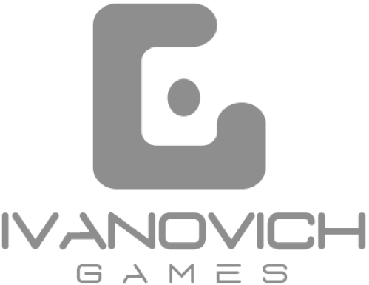

Technologies in the video game industry (I)
1 | The debate about the use of generative artificial intelligence (AI)
The studios are divided on the impact of generative AI on video game creation; it can boost creativity, reduce costs and streamline the development process, but at the same time it can lead to mass layoffs and copyright infringements.
In 2022, King acquired Peltarion (a Swedish company specializing in artificial intelligence) and acknowledged this technology as a key area in the company’s current strategic direction. This move demonstrates its anticipation in the adoption of AI solutions and positions King, which operates in Barcelona, at the forefront of the development of AI-driven games.
2 | Virtual reality (VR) and augmented reality (AR) are looking more promising than ever before
Sales of VR/AR glasses will continue to grow, driven by an ever-increasing number of actors targeting different audiences. Work is underway on affordable versions of these devices to help increase market penetration.
Ivanovich Games, a video game development and publishing company based in Catalonia, focuses in particular on virtual reality games. Its most successful VR game to date is Operation Warcade, a shooter inspired by the arcade classics of the 1980s that takes advantage of the new technologies to offer a unique experience.
3 | The metaverse, a virtual world full of opportunities
Interconnection lies at the heart of the metaverse: players will be able to move from one game to another while maintaining their digital identities, possessions and milestones. The studios will have to collaborate to create shared universes and multi-platform experiences.
Champion Games, the Catalan video game studio, lies behind the creation of MetaSoccer, the first blockchain technology-based soccer metaverse with which users can manage their own club and generate income while playing. This pioneering video game skillfully combines blockchain technology, decentralized finance, sports betting and football.
Source: ACCIÓ, based on Global Games Market Report, Newzoo, 2022 and 2023; White paper on Spanish video game development, DEV, 2022; Video Games in Spain, Euromonitor, 2023; Two Technology Trends Shaping The Future Of Gaming, Forbes, 2023; The Gaming Playbook, GWI, 2021

Slide 49


Technologies in the video game sector (II)
4 | Is cloud gaming the future of video games?
Internet access is constantly improving and the connection requirements of cloud games are less strict thanks to technological advances. For this reason, the target audience for cloud gaming will almost triple between 2021 and 2025.
The pioneers in leveraging cloud technologies for innovative streaming solutions for video games include Ubisoft, a leading studio operating in Barcelona. Its teams are actively working on the development of this technological base, which will allow it to radically transform its production processes and IT infrastructure.
5 | Web3 technology and blockchain: in-game asset ownership remains a driving force
Web3 technology, powered by blockchain and decentralized protocols, is destined to revolutionize the video game industry. Players will be able to trade, sell and transfer their digital objects across different platforms in the form of non-fungible tokens (NFTs), which will open up new sources of income and foster a thriving digital economy.
Starloop Studios, a company operating in Catalonia, has major expertise in the industry related to the tokenization of fungible and non-fungible assets. It helps design and mint NFT assets that bring high value propositions to people.
Source: ACCIÓ, based on Global Games Market Report, Newzoo, 2022 and 2023; White paper on Spanish video game development, DEV, 2022; Video Games in Spain, Euromonitor, 2023; Two Technology Trends Shaping The Future Of Gaming, Forbes, 2023; The Gaming Playbook, GWI, 2021

Slide 50
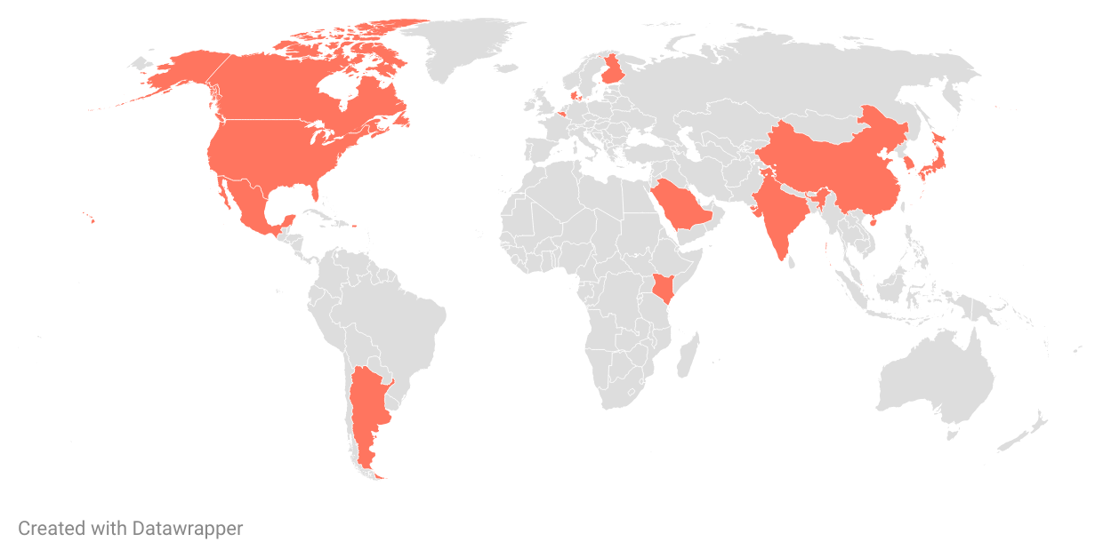




International business opportunities for video games
Belgium
Digital Europe Strategy: a pillar in the EU and Belgium
Denmark
Denmark and video games: the perfect match for Catalonia
Finland
Finland, at the forefront of the global video game industry
Kenya
Kenya and ICT: the Silicon Savannah
Saudi Arabia
Look out, gamers: video games are on the rise!
India
India, an upward trend in the video game industry
World
Singapore
Singapore, the regional eSport center
Japan
Trends in Japan: video game market
USA
California: the global hub of the audiovisual industry
Mexico
Shall we play together? Collaboration with Mexican creators
China
Conquering the virtual world. China, a key destination for video games
South Korea
Video games in South Korea, one of the most important global markets
Canada
World leader in the field of immersive experiences
Argentina
A growing industry
Note: The opportunities of other sectors related to the video game industry have also been taken into account
Source: Global Map of International Business Opportunities 2023

Slide 51


Thank you!
https://www.accio.gencat.cat/ca/serveis/banc-coneixement/cercador/BancConeixement/eic-els-videojocs-a-catalunya
https://www.accio.gencat.cat/ca/sectors/videojocs/

